Slide 1


Second Hand Bike Markets Insights & Price Intelligence Using Web Scraping
Presented By:
M. SivaKumar
Batch: 442

Slide 2
Agenda
Business problem
Problem Statement
Data Preprocessing
Cleaned Data
Data Visualization
Hypothesis testing
Conclusion

Slide 3
Business problem
The second-hand bike market operates in a largely unorganized and data-poor environment where prices are set inconsistently due to the absence of standardized valuation methods and reliable market intelligence. This leads to reduced customer trust, inefficient pricing strategies for sellers and dealers, and missed revenue opportunities for online resale platforms. Businesses therefore struggle to make informed, data-driven decisions about pricing, demand forecasting, and competitive positioning in the resale market.

Slide 4
Problem statement:
Prospective buyers of second-hand bikes face the risk of overpaying due to information asymmetry and the difficulty of assessing a bike's true worth from listed prices. This project tackles this problem by deconstructing the factors that influence resale value. Through exploratory data analysis and visualisation , we provide a clear framework for buyers to identify fairly priced bikes and negotiate effectively, ensuring they get the best value for their money.

Slide 5
Motives
What amount is required to buy a vehicle (second hand)?
How Registered year impact price of the vehicle.
Which Vehicle to choose an over-travelled one or the vehicle that has travelled less Km’s.
What should your trust (brand or Service)?
Where to look for more options?

Slide 6
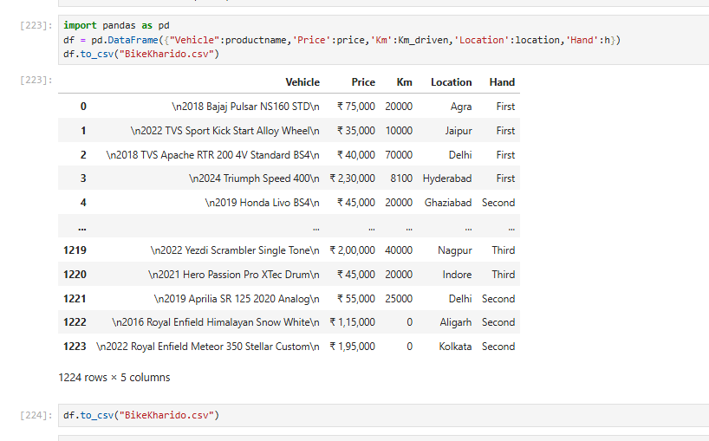
Raw Data

Slide 7
Data preprocessing
After executing the program , created a DataFrame using dictionary and check whether the data inside it is cleaned or not .
For cleaning the data in the dataframe ,check for the null values and duplicate data, if all the null values in columns is zero then it is appropriate for further processing.
Cleaned text data by removing unnecessary whitespaces, special characters, and HTML tags from text data and removed irrelevant information using Regex.
Removed \n,\div, rupee symbol . Extracted Brand and year for product.
Converted the data types. By default all the types of columns are objects, changed according to the column like float32 or int32 etc..
Check the shape of the database and saved the cleaned data into csv.

Slide 8
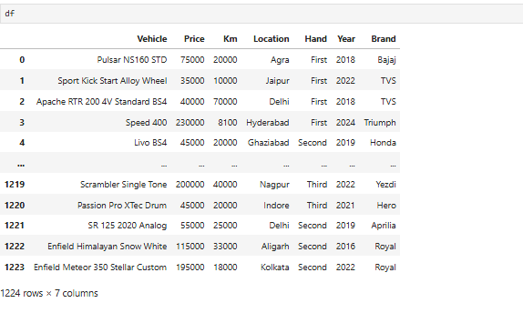
Quick view of Cleaned data

Slide 9
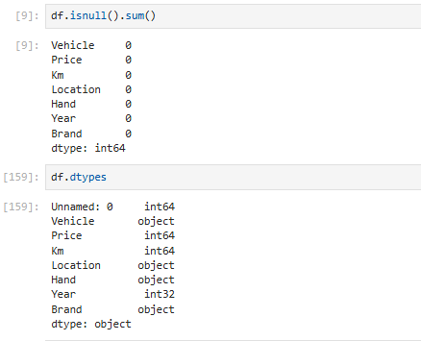

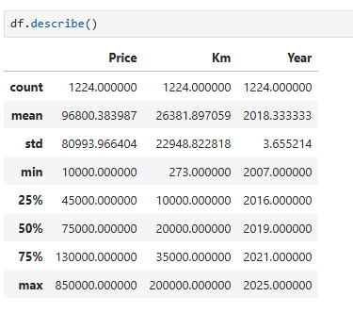
Type and shape of data

Slide 10
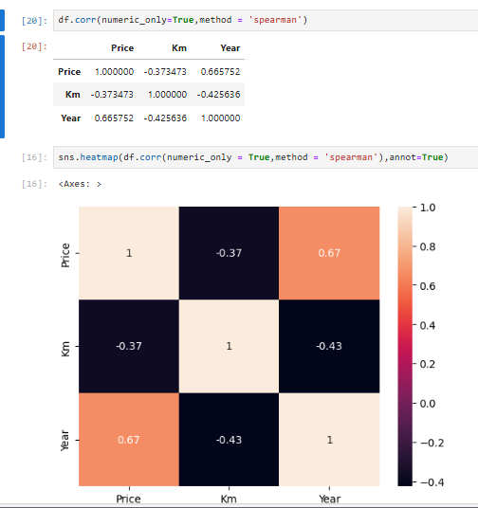
Finding correlation of data
Multi variate analysis
* KM driven are impacting price negatively(Weak)
* Year of the registration is impacting the price of the Positively(moderate).

Slide 11
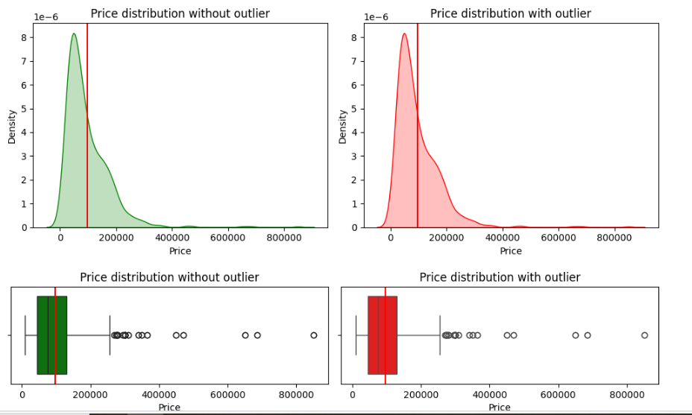
What is the average price of second hand bike and Evaluate the reason for such price(high or low)?
Univariate Analysis
Average Price of a bike is Rs.96800
Most of the bikes cost range from Rs.25000 to Rs.200000
There are High Expensive Bikes beyond Rs.400000
The cost of the most expensive is Rs.850000*
Excluding expensive bikes average price of a bike is Rs.66000.

Slide 12
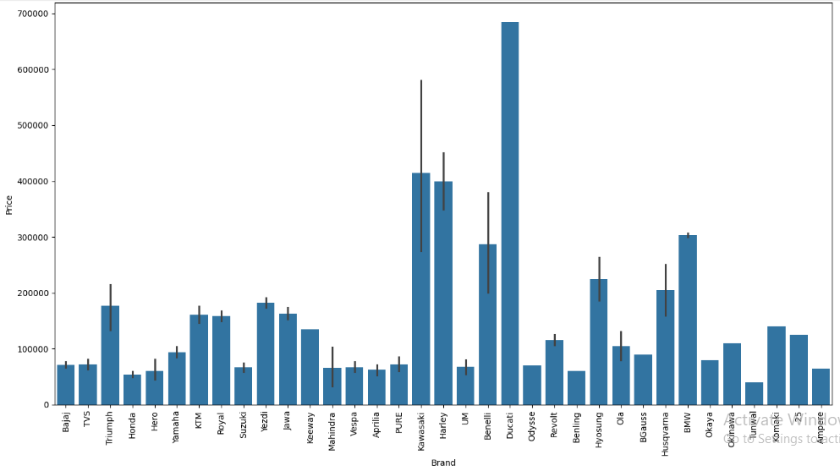
What are those Expensive Bikes?
Univariate Analysis
Ducati,Kawasaki,Harley,BMW,Benelli brand has the highest priced vehicle (Avg:Rs 496666)

Slide 13
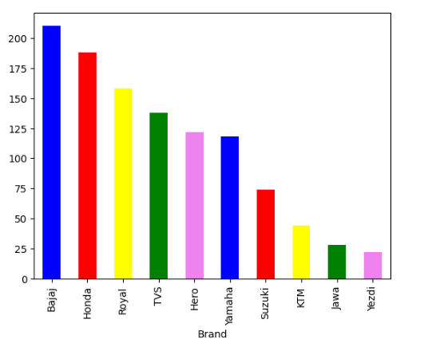
Listings of bikes in different brands
* More vehicles are available in Bajaj(210) brand followed by Honda(188) , Royal Enfield(158) , TVS

Slide 14
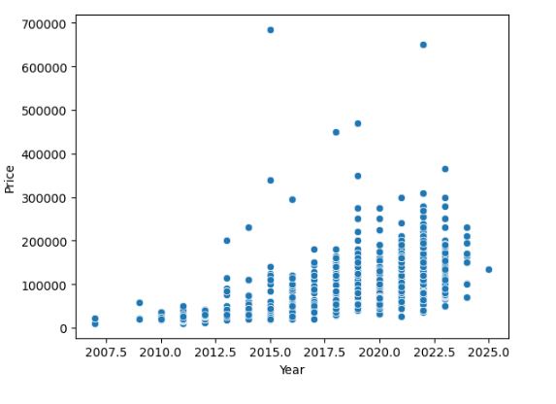
Taking Year into consideration
Bivariate Analysis
when we ignore outliers the graph indicates a positive curve which indicates .
The latest bikes are costly than the old bikes.
If you want to own a latest bike you have to pay more

Slide 15
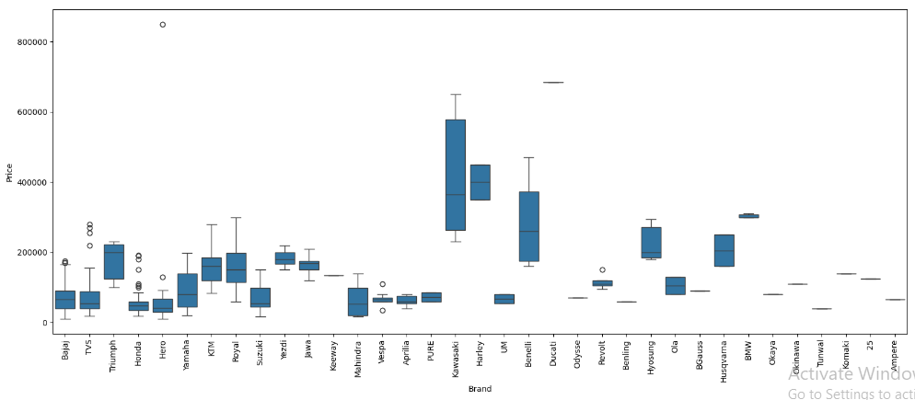
Range of bikes price based on brand?
Brand is highly influensing Price of a bike
Harley bike starting range is more than price is 300000
kawasaki,Benelli,Hyosung bike starting range is more than price is 200000
Most of the bike brands cost is below 200000

Slide 16
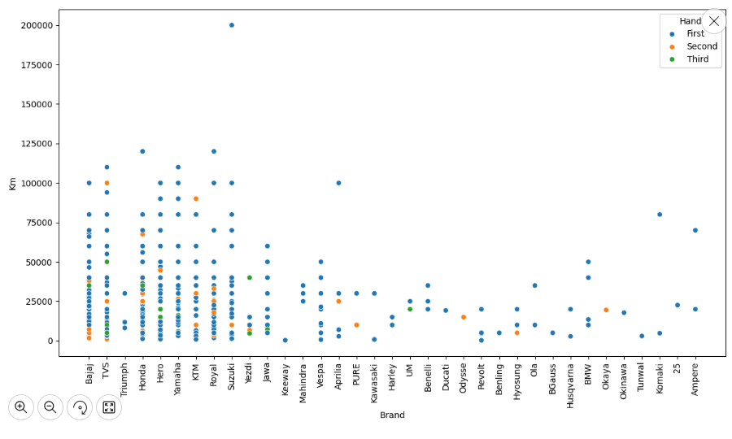
Top performing Brands
A Suzuki vehicle has travelled around 2LAkh KM's. (penetrated brand : Bajaj, Service : Suzuki)
Honda and Royal Enfield vehicle has travelled nearly 1,25,000.
If we choose these vehicles to buy for second hand they might be worthy

Slide 17
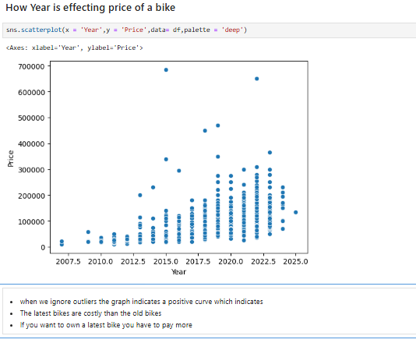
Year vs Price

Slide 18
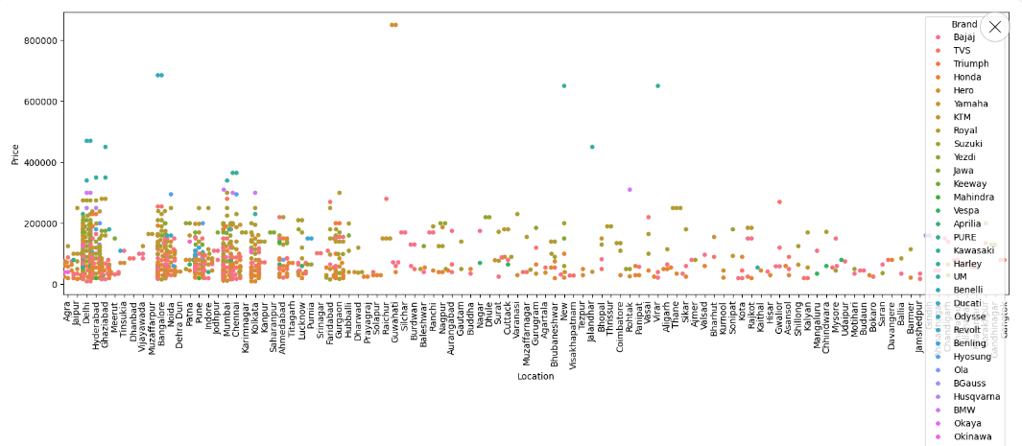

Where you might get more options?

Slide 19
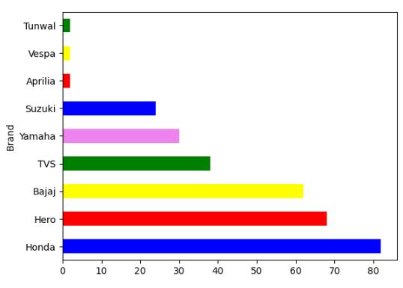
When the budget is between 20 thousand to 50 thousand what are the brands available in this budget?
Honda ,Hero,Bajaj,TVS,Yamaha,Suzuki are the brands available for the budget of 20 to 50 thousand

Slide 20
Hypothesis testing
To statistically validate whether the KM Driven significantly influence the Price of Second-Hand Bikes.
Hypothesis – KM Driven vs Price
H0 (Null Hypothesis): KM Driven does not affect Bike Price.
H1 (Alternative Hypothesis): KM Driven negatively affects Bike Price.
Test Method: Pearson Correlation
Correlation (KM vs Price): 0.5308350020895821
P value:2.2758926087520894e-06 (This means 0.00000227)
If p < 0.05 → Reject H0
Conclusion:Hypothesis testing statistically validated that the KM Driven significantly influence second-hand bike pricing.

Slide 21
Key insights
Year of registration is the strongest factor influencing resale price.
KM driven has a statistically significant but weaker negative impact on price.
A small group of premium brands (Ducati, BMW, Harley, Kawasaki, Benelli) heavily skews overall price averages,

Slide 22
CONCLUSION
After Scraping and analyzing the data from BikeKharido.com it is evident that More than Registered year, Km’s driven and Brand are influencing the price of a Bike.
Most Penetrated brand is Bajaj where as most performing brand is suzuki.
Metropolitan cities have diverse choices than other areas.
The lesser distance the bike had travelled the more expensive the bike would be.
How latest the bike is as expensive it would be.

Slide 23

THANK YOU

